Slide 1

Tracker 3
The Future is Present
Desktop search, since 2005
Carlos Garnacho & Sam Thursfield
GUADEC 2020

Slide 2

Desktop search, since 2005
A brief history...

Slide 3
Talk contents:
When can we have it?
What's new?
  Improvements for apps
  Improvements for users
  Improvements for developers
How can you contribute?

Slide 4

1. “When can we have it?”

Slide 5
“When can we have it?”
Tracker 3 release plans
Big changes!
Database format has changed.
C and D-Bus interfaces have changed
Tracker 3 is parallel installable with Tracker 2
~/src/tracker> git diff origin/tracker-2.3..origin/master --stat -- docs examples src tests utils |tail -n 1
884 files changed, 25637 insertions(+), 67827 deletions(-)
~/src/tracker-miners> git diff origin/tracker-miners-2.3..origin/master --stat -- data docs src tests | tail -n 1
370 files changed, 39819 insertions(+), 10231 deletions(-)

Slide 6
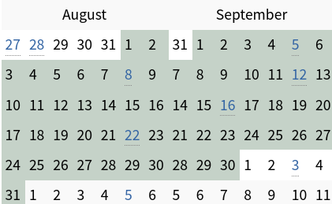
“When can we have it?”
Tracker 3 release plans
GNOME 3.38
https://wiki.gnome.org/ThreePointThirtyseven
3.37.90 release – 8th August 2020
3.37.91 release – 22nd August 2020 (String freeze)
3.37.92 release – 5th September 2020 (Code freeze)
3.38.0 release – 12th September 2020

Slide 7
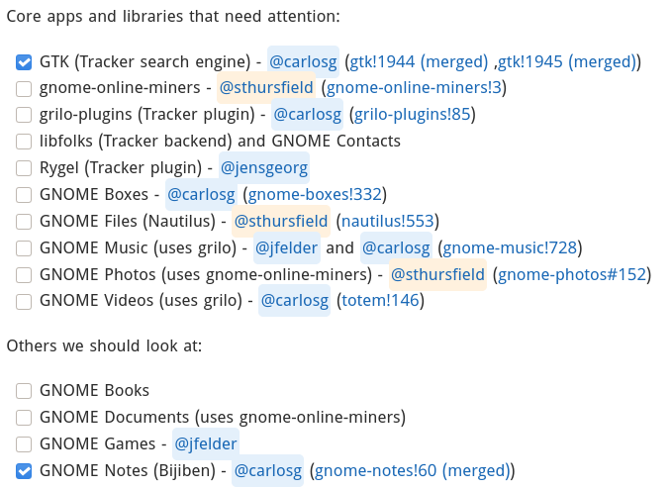
“When can we have it?”
From https://gitlab.gnome.org/GNOME/Initiatives/-/issues/17 ...

Slide 8

https://blog.codinghorror.com/the-works-on-my-machine-certification-program/

Slide 9
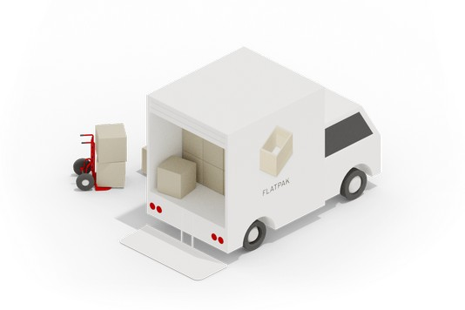
“When can we have it?”
Plan B
Tracker 3 Miners will work inside a Flatpak bundle.
Apps can use 3.x while core depends on 2.x, if needed.

Slide 10
How it can be packaged
Plan A: Update existing tracker packages, mark 3.x as conflicting with 2.x
Plan B: Add new tracker3 and tracker3-miners packages

Slide 11

2. What‘s new?

Slide 12
Improvements for apps
Data isolation
Built on top of SPARQL language features
  Sits well with SPARQL
  Sits well with us
Reasonably sized chunks
  Video
  Audio
  ...

Slide 13
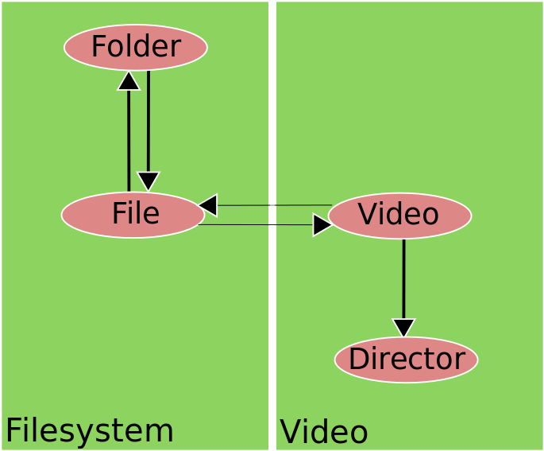
Anatomy of a file

Slide 14
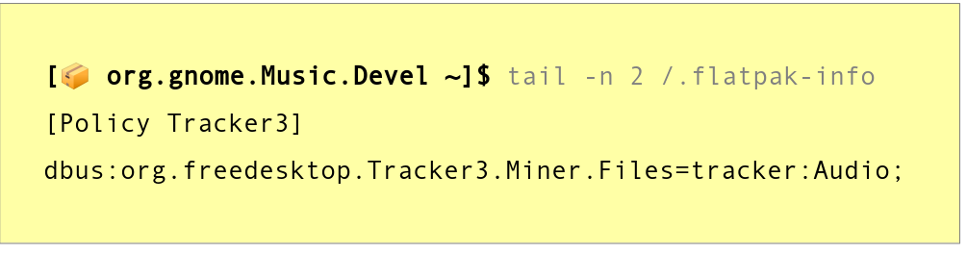
The secret sauce
[📦 org.gnome.Music.Devel ~]$ tail -n 2 /.flatpak-info
[Policy Tracker3]
dbus:org.freedesktop.Tracker3.Miner.Files=tracker:Audio;

Slide 15
Improvements for apps
Stores and endpoints
tracker_sparql_connection_new() creates a SPARQL triple store
  Pretty much in the SQLite sense
TrackerEndpoint makes a TrackerSparqlConnection public
  DBus currently
SPARQL ties it together with service graph patterns
Mixed together, we get a distributed database

Slide 16
Application A
Consumes tracker-miners data
Does not need to store anything
→ tracker_sparql_connection_bus_new()

Slide 17
Application B
Does not consume tracker-miners data
Stores its own data
→ tracker_sparql_connection_new()

Slide 18
Application C
Consumes tracker-miners data
Stores its own data
→ tracker_sparql_connection_new()
→ Explicit service graph patterns

Slide 19

Exporting 2.x data
tracker export --data=files-starred | ./nautilus-import-starred-files
Tracker 2.3 gains tracker export command.
Import scripts (ready for apps to ship) https://gitlab.gnome.org/sthursfield/tracker-data-migration-tools/

Slide 20
“What‘s new?”
Improvements for users
Data security
Online documentation
Commandline improvements

Slide 21
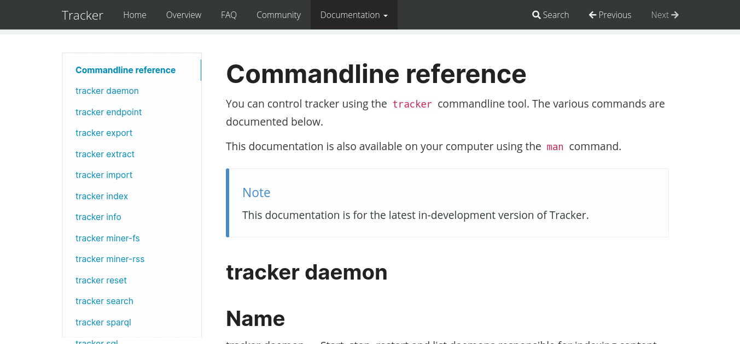
“What‘s in it for me?”
Improvements for users
https://gnome.gitlab.pages.gnome.org/tracker/

Slide 22
“What‘s new?”
Improvements for users
Extensible CLI, git alike
Modernized, some nice references:
  coredumpd
  systemctl
  sqlite
Gateway to all of Tracker

Slide 23
“What‘s in it for me?”
Improvements for current developers
Streamlined API
  SPARQL library
  org.freedesktop.Tracker3.Miner.Files DBus name and interface
Better documentation
Standards compliant
Easy sandboxing
Easy testing
Better validation tools

Slide 24
“What‘s in it for me?”
Improvements for current developers
Still fit!
  Low footprint
  Fast
    ~350K updates in 30s
    ~6M queries in 30s
    * Recorded in ideal circumstances

Slide 25
“What‘s in it for me?”
Improvements for tentative developers
It is not just about indexing anymore
All benefits from SQLite, different mindset
  And more on top
No impositions
  Your own schema^Wontology
  Your own data
You can also benefit from sandboxing!

Slide 26
“What if …?”
Endpoints, endpoints everywhere
Application data does not necessarily stay in the application
  Everyone can be an endpoint
  Lightweight search providers
Import/export + endpoints → data synchronization
  “Synchronization” panel in Settings?
Sprawling search
  Local network machines
  Virtual machines

Slide 27
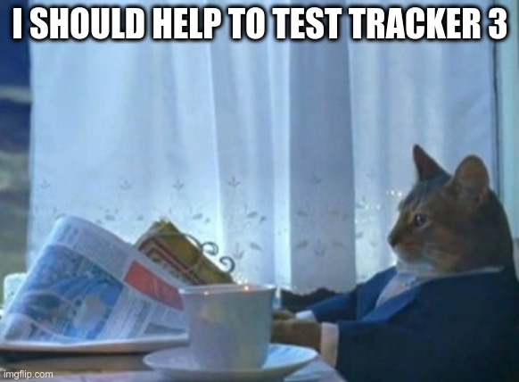

Slide 28

How to get involved
Everyone can … test the apps!
→ Look for a .flatpak artifact in the merge request.
Developers can … package Tracker 3 in distros
… review merge requests
… label on gitlab.gnome.org
Get in touch!
Join #tracker:gnome.org on Matrix / #tracker on IRC
Use tracker tag on discourse.gnome.org

